Slide 1
Project 4:Docker
Submitted by -
K. Abhinay
Guided by -
Sir Ashish

Slide 2
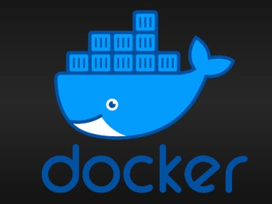
Docker
Docker is an open platform for developing, shipping, and running applications. Docker enables you to separate your applications from your infrastructure so you can deliver software quickly. With Docker, you can manage your infrastructure in the same ways you manage your applications. By taking advantage of Docker’s methodologies for shipping, testing, and deploying code quickly, you can significantly reduce the delay between writing code and running it in production.

Slide 3
Docker provides tooling and a platform to manage the lifecycle of your containers:
1.Develop your application and its supporting components using containers.
2.The container becomes the unit for distributing and testing your application.
3.When you’re ready, deploy your application into your production environment, as a container or an orchestrated service. This works the same whether your production environment is a local data center, a cloud provider, or a hybrid of the two.

Slide 4
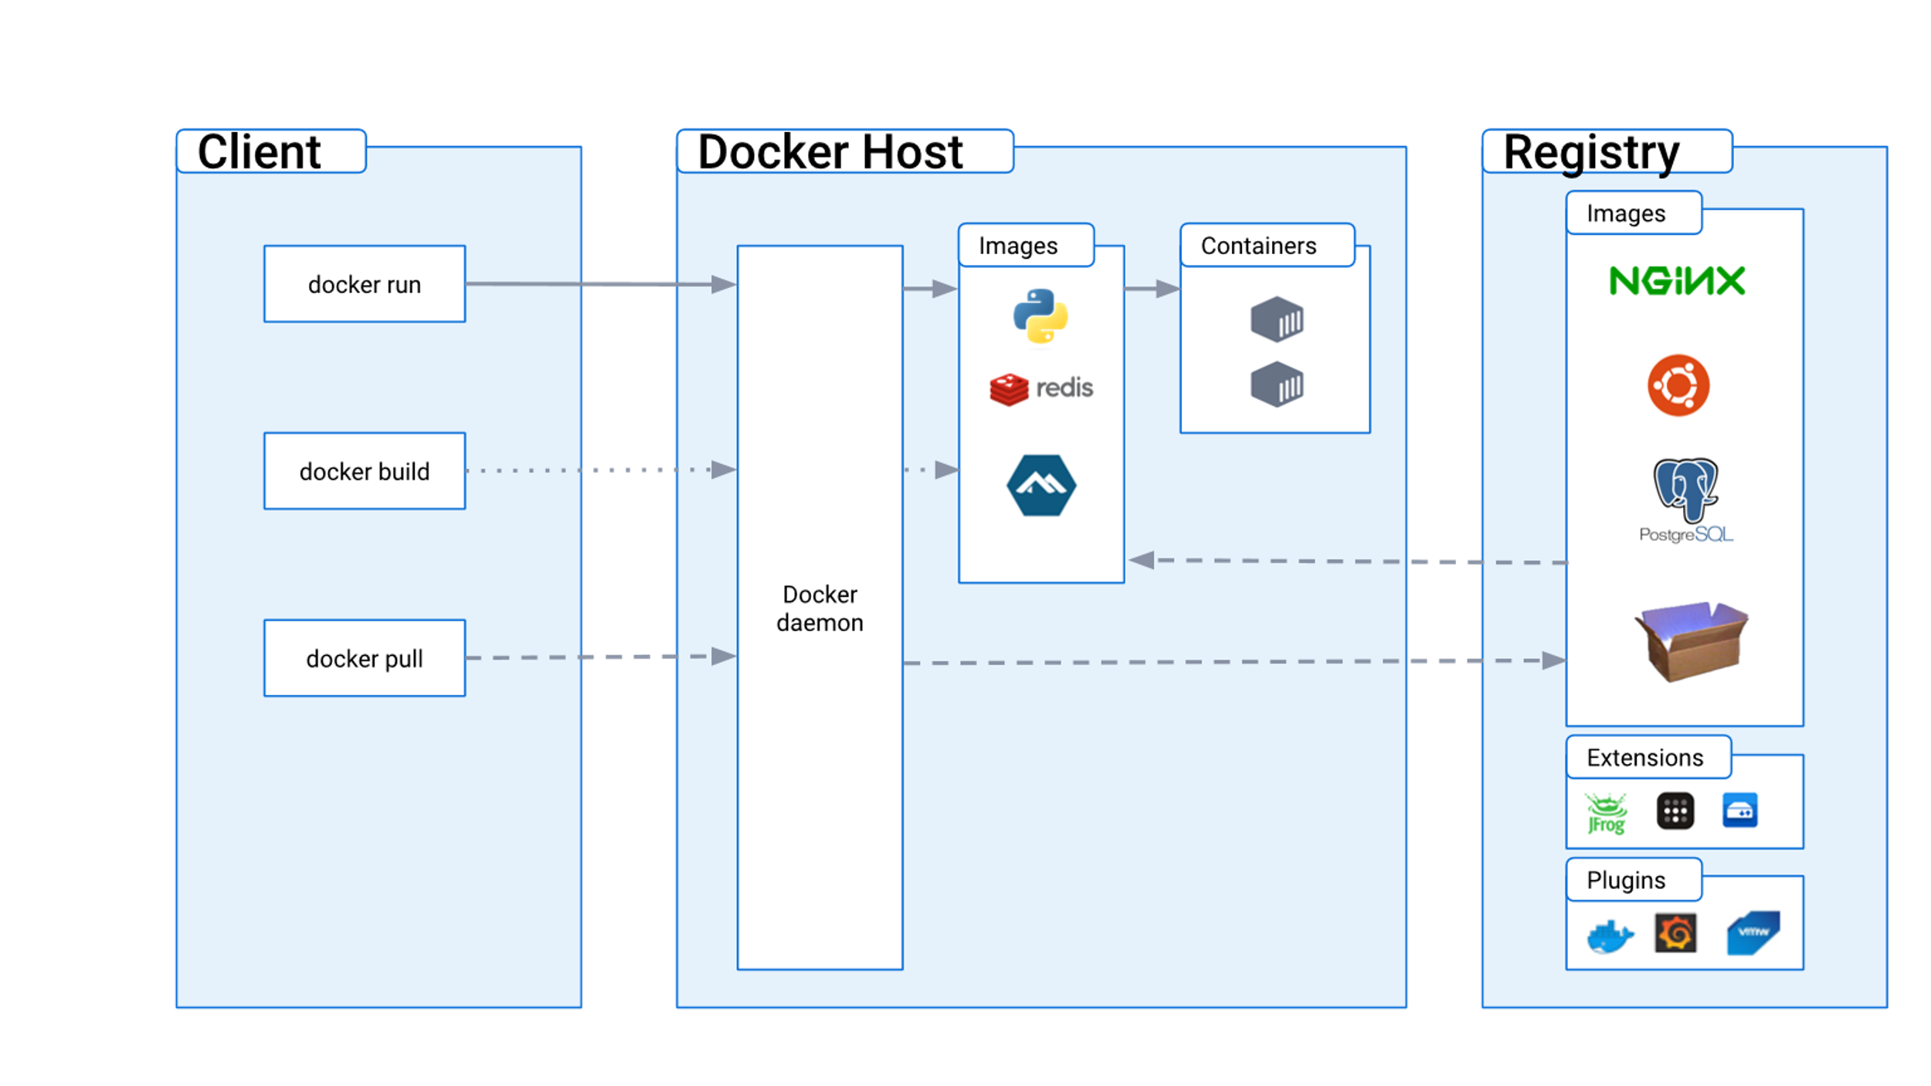
Docker architecture

Slide 5
Project 4:
docker install
service start
docker pull
docker run
(1)os based image
(2)application based images
(2.1)httpd
(2.2)mysql
docker networking
#custom website on the port 8080.
public_ip:8080
#hello lnb team

Slide 6
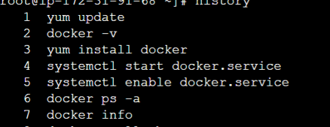
Docker install:
Create an ec2 instance and ssh in your terminal and type these commands to install docker

Slide 7
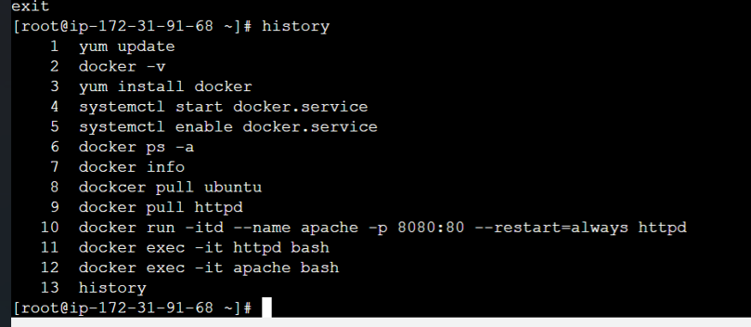
Pulling httpd image and running on web browser:

Slide 8
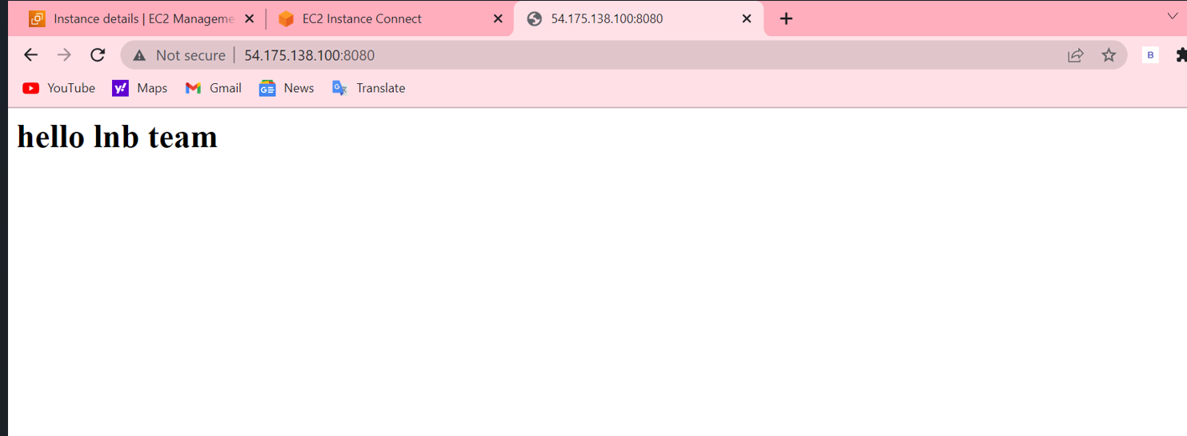
The IP address will be the public Ip of your instance:on port-8080

Slide 9
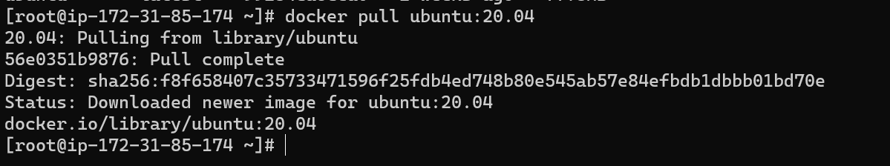
Pulling OS based image: Ubuntu

Slide 10
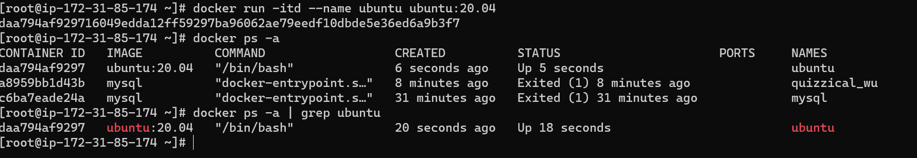
Running Ubuntu :

Slide 11
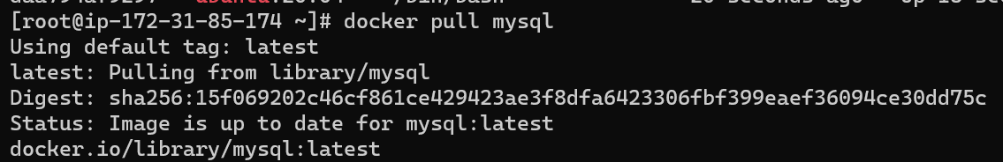
Pulling mysql image:

Slide 12
Running mysql

